Slide 1


Corporate
Overview
https://delvictechnologies.com

Slide 2
Delvic
Technologies
We develop applications in an organic way, our people work to amplify human potential and create the next opportunity for people, businesses and communities, empower the business with agile digital at scale and drive continuous improvement with always-on learning ,through the transfer of digital skills, expertise, and ideas from our innovation ecosystem. We are deeply committed to being a well-governed, environmentally sustainable organization where diverse talent thrives in an inclusive workplace.
http://delvictechnologies.com/
http://
delvictechnogies.com/lo

Slide 3





Why
Delvic
Some of the best minds and talent are part of our team
Cost effective and top quality Software Development
We take ownership of the issue and accept the challenge
We realize that every customer's need is unique. With our young and expert
team, we can offer our clients a high-quality services that are very specific and exclusive
We strive continuously for improvement and Challenge all the assumptions
Decisive, responsible and accessible

Slide 4



About
Organic App Development
We develop applications in an organic way.
A step-by-step development methodology
Delvic
We are a global IT service provider. experts in designing and developing websites and web applications in professional and cost effective way
Our Services
IT Services
ITES/BPO Services
Exclusive Services
high-quality services that are very specific and exclusive to your requirements
Consulting Services

Slide 5




Mission &
Vision
Our desire is and will always be to build an institution that will outlast our generation. We are a young group of exceptional, passionate, hard working and energetic people with a specific mission.
Mission
We always strive for offering meaningful, customized products and services to our clients
Vision
Based on mutual exchange of value, we desire to
establish long term business-relationship with our clients

Slide 6



IT Services
  Web/Mobile applications
  Desktop applications
  Data Warehousing
  Data Analytics and Reporting
  Big Data management
ITES/BPO Services
  Full Search process
  Property Locating Services
  Data Entry
  Customer call services
Consulting Services
  Resource outsourcing
  Product Sales and Marketing. Currently we do have Pet Care app and School/College management app
  Solutioning for the problems
  Develop Recommendations
Our
Services

Slide 7


We Are A
Creative
We have the capability to develop websites and enterprise grade applications.
We use commercial and open-source technologies for our web developments.
Design
Agency
Web Design
We design highly responsive websites for
small, medium and enterprises companies
  Fully responsive websites with minimal design
  Clean code and SEO friendly website for business promotions
  Social media marketing and accessible website

Slide 8


We Provide
Data Engineering Solutions
Data Discovery
Data Visualization
collection and evaluation of data from various sources to understand trends and patterns in the data
It is a long-established fact that a reader will be distracted by the readable content of a page when looking at its layout.
Digital Transformation accelerates your business growth.
Put your databases’ management on auto-pilot and free team capacity for more strategic initiatives with fully-managed solutions
Data Analytics
Data is a company’s most strategic asset
Data Analytics is the systematic computational analysis of data or statistics. It is used for the discovery, interpretation, and communication of meaningful patterns in data. It also entails applying data patterns toward effective decision-making.
ETL
Provide a single, unified view of data from various sources to support business decision-making and analysis.
Increases operational efficiency and savings
Creates more value for customers

Slide 9
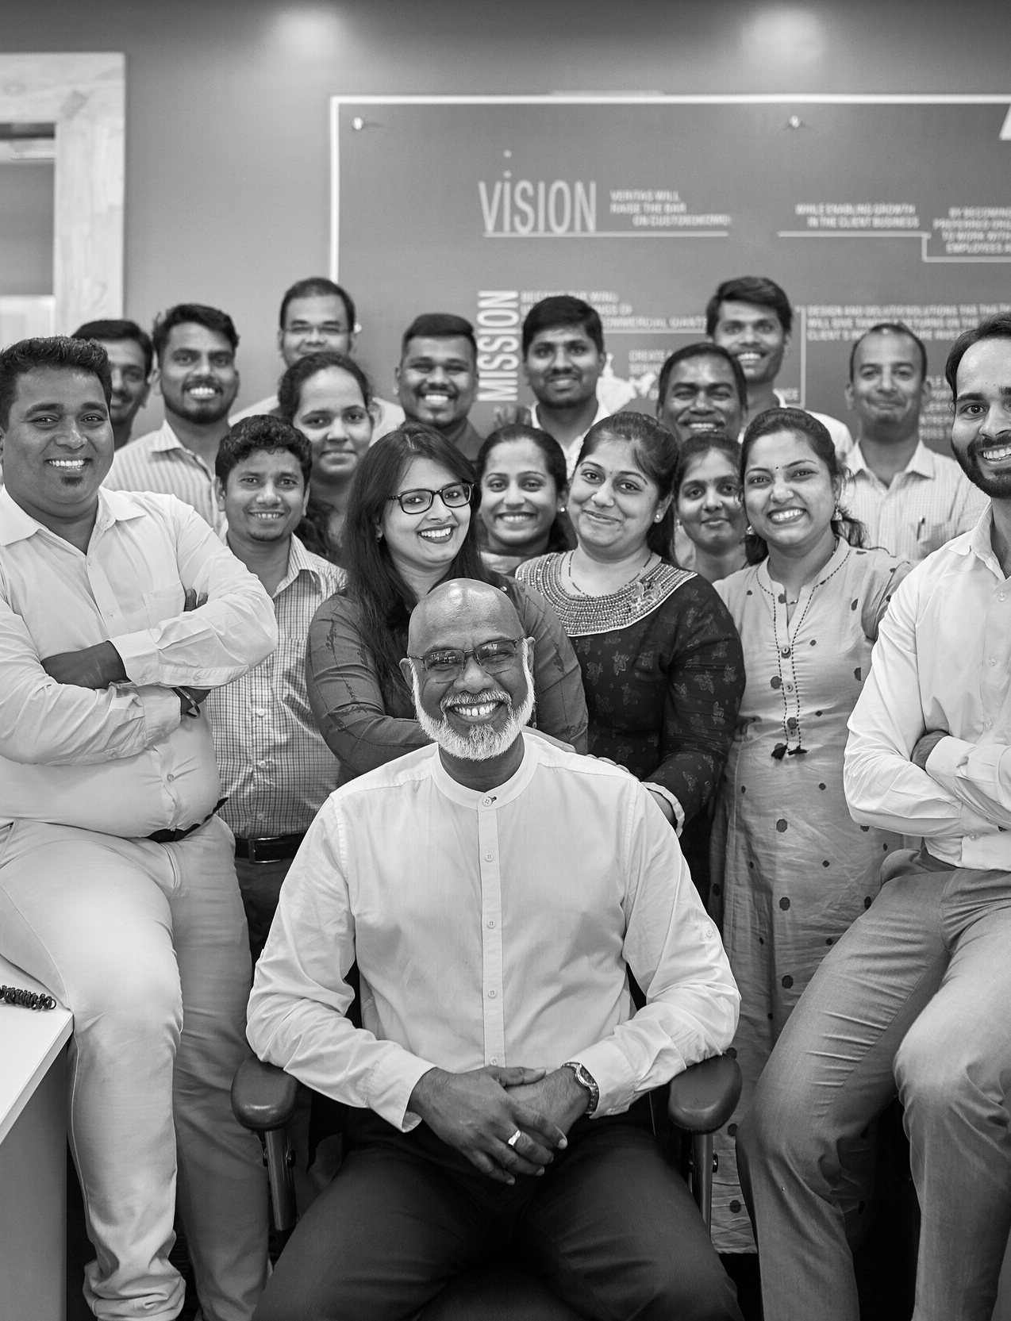

Staffing &
Resource Management
Outsourcing IT services to India offers many advantages for businesses looking to save costs, access skilled IT talent, and receive high-quality IT services
Cost savings
Skilled workforce
One of the main advantages of outsourcing IT services to India is that it can lead to significant cost savings.
India has a large pool of highly educated and skilled IT professionals, making it an ideal location for outsourcing IT services.
Time zone advantage
Quality of services
India is in a different time zone making it possible for businesses to access IT support 24 hours a day. This is especially useful for companies that need to resolve technical issues outside of normal business hours
Indian IT companies are known for providing high-quality services at competitive prices. They invest in the latest technologies and equipment to deliver efficient and reliable IT services.

Slide 10


Consulting &
Proposed New Business Expansion
Staffing
We at Delvic aim to provide IT consulting services allow our clients to bring the best technological solutions to their business goals and those needs can cover “anything and everything” IT-related. We believe in our Strong Ethics with the following
Strategy: creating a long-term plan that defines how IT will support the business
Architecture: designing the plans and guidelines to build IT systems
Implementation: overseeing the execution of the IT plan
Systems integration: connecting different parts of the IT system and ensuring they work together
Data analytics: capturing, processing, and analyzing data to help answer business questions
Security: creating a strategy to prevent unauthorized access to hardware, networks, and data, and ensuring systems are compliant
Software management: planning and leading software projects, including scheduling, tracking, and delivery of code
ERP (enterprise resource planning) services: helping choose the software the company uses for daily business activities (like project management)
Current Scenario
Provide resources to M2-D2 with resource management under Delvic payroll from India
Other Staffing Options
Local outsourcing - selecting an outsourcing partner in your country.
Offshoring - finding a dedicated team outside of your country of operations.
Nearshore outsourcing - A company in a country that is not far away from yours. For ex: Canada and US

Slide 11


If the above opportunity excites you and would like to be part of this growing tech community
Don’t hesitate to email to the below address and reach out to us to know more about our services that we offer
We will be always be happy to help your needs.
Assuring our best services.
Our Testimonials : we are now serving European counterparts to be part of our growing family.
POC:-Rajshekar
Email:-corps@delvictechnologies.com
https://delvictechnologies.com/
https://delvictechnologies.com/
https://delvictechnologies.com/
Visit Here:
www.reallygreatsite.com

Slide 12
Thank
You
Visit Here:
www.reallygreatsite.com

